Slide 1
Synthetic Mobile Phone Store Sales Analysis And Consumer Buying Trends
ODUNAYO ANIMASHAUN

Slide 2
PROJECT OUTLINE
1.Introduction
2.About the Dataset
3.Problem Statement
4.Aim and Objectives
5.Research Questions
6.Charts and Visualizations
7.Conclusion/Discussion
8.Recommendation
9.Challenges faced

Slide 3
INTRODUCTION
TKOD Phone Store is a retail store with stores in various countries that specialize in the sales of different brands of smartphones.
This store serves as important point where customers from different countries purchase new and original smartphones of choice

Slide 4
ABOUT THE DATASET
TKOD Phone Store dataset is a structured collection of information related to the store sales operation. It is used for analysis, inventory management, and business decisions.
The fields that appeared in the TKOD Phone Store Dataset include:
Model: Phone Model name
Price/ Price-USD: Selling price for a unit of phone/ The selling price in dollars
Brand: Manufacturer for a Phone Model. There were a total of 10 brands in the dataset analyzed.
Payment Method: Medium of payment and it was through cash, installments, credit card and so on.

Slide 5
Problem Statement
TKOD Phone Store records large amounts of sales data from its mobile phone transactions. However, without proper analysis, it is difficult to clearly understand sales performance, customer preferences, and product demand.
This makes it challenging for the store to identify which brand perform best and how sales change over months.
Therefore, there is a need to analyze the sales data and present it in an interactive dashboard that provides clear insights to support better business decisions.

Slide 6
AIM AND OBJECTIVES OF THE STUDY
The aim of this study is to analyze the sales data of TKOD Phone Store and visualize key sales insights using an interactive dashboard.
The objectives of the study are:
Analyze the total revenue generated from smartphone sales.
Determine the total number of smartphone units sold.
Examine the monthly trend of smartphone sales.
Evaluate customer satisfaction using average ratings.

Slide 7
Research Questions
How do smart phone unit sales vary across different months in 2025?
Which smart phone brands generated the highest total revenue?
Which smart phone model generated the highest total revenue?
What payment methods do customers most commonly use when purchasing mobile phones?

Slide 8
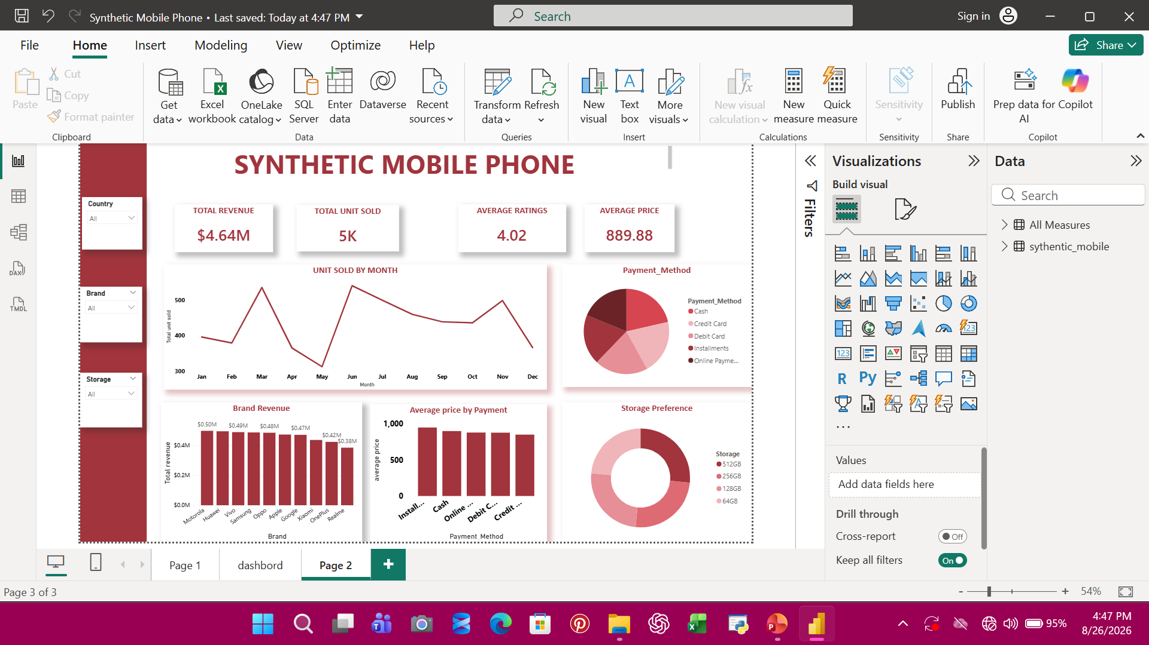

Slide 9
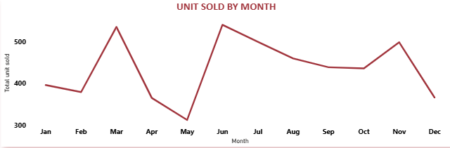

Slide 10
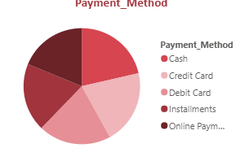

Slide 11
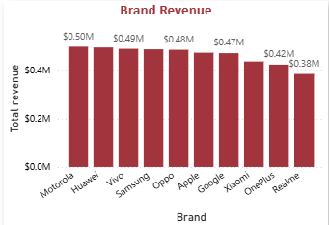

Slide 12
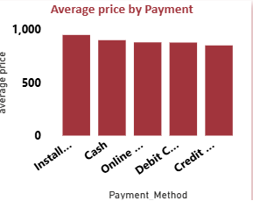

Slide 13
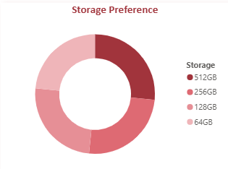

Slide 14
CONCLUSION
Based on the analysis, it can be concluded that the business is currently performing well in terms of revenue generation but faces significant challenges that may affect its future sustainability.
The declining sales trend is a major concern, indicating potential weaknesses in marketing, product strategy, or market positioning.
Additionally, the moderate customer satisfaction level suggests the need for improved service delivery.
Although the company benefits from a diversified brand portfolio and flexible payment options, the lack of a dominant product or brand limits its competitive advantage.
Overall, the business is profitable but strategically vulnerable, requiring immediate attention to sustain growth and improve performance.

Slide 15
RECOMENDATIONS
Based on the findings, the following recommendations are proposed
1. Improve Sales Through Strategic Marketing
2. Enhance Customer Satisfaction
3. Focus on High-Performing Products
4. Address Declining Sales Trend
5. Leverage Flexible Payment Options
6. Strengthen Brand Strategy
7. Improve Data Utilization

